Slide 1
Certification Project
AI/ML for Networking
K V Sahishnav Reddy
P Sai Moukthi
Thakur Pragathi
Dept of Computer Science & Engineering

Slide 2
Description
Modern network environments are increasingly vulnerable due to complex and encrypted traffic and evolving cyber threats. Traditional rule-based security methods are inadequate for real-time threat detection, especially in encrypted traffic. This internship explores the integration of Artificial Intelligence and Machine Learning to analyze network traffic, classify applications, and detect anomalies in real-time. The goal is to build a scalable, AI-powered framework that enhances threat detection accuracy, preserves user privacy, and minimizes human intervention in network defense.
Dept of Computer Science & Engineering

Slide 3
AI/ML for Networking
Our Solution :
Modern networks handle a huge amount of traffic, much of it encrypted, making it hard for traditional security systems to keep up. These older methods often miss threats or react too slowly. This project uses AI and machine learning to analyze network traffic and spot unusual activity in real time. The goal is to make network security faster, smarter, and more accurate.
Dept of Computer Science & Engineering

Slide 4
AI/ML for Networking
Goals :
To develop an AI/ML-based system for real-time traffic classification
To improve detection accuracy for encrypted threats
To minimize false positives and false negatives
To ensure scalability for high-traffic environments
Dept of Computer Science & Engineering

Slide 5
AI/ML for Networking
Code Overview -(Model Training & Real-Time Classification)
1. train_model.py :
Preprocesses dataset and extracts statistical features
Splits dataset and trains a Random Forest classifier
Saves model as model_rf.pkl for deployment
2. capture & classifier :
Captures live packets
Extracts features from packets in real time
Loads model_rf.pkl to predict traffic type
Flags potential threats based on classification
Dept of Computer Science & Engineering

Slide 6
AI/ML for Networking
3. features_extractor.py
Functions to transform raw packets into ML features
Calculates stats like packet size, entropy, flow duration
Used in both training and real-time classification
4. web_dashboard.py
Runs a Flask/Django-based dashboard
Displays classified traffic and alerts in real time
Provides logs for analysis
Dept of Computer Science & Engineering

Slide 7
AI/ML for Networking
Technologies Used :
Languages: Python
Operating System: Windows
ML Algorithm: Random Forest (trained and serialized in model_rf.pkl)
Libraries: Scikit-learn, NumPy, Pandas, Joblib, Matplotlib, Scapy
Web Framework: Flask/HTML (for dashboard)

Slide 8
AI/ML for Networking
Work Done
Collected and preprocessed network traffic
Extracted statistical features like packet size, duration, and flow behavior
Trained a Random Forest model to classify traffic types
Built a real-time traffic classifier using Python
Developed a web dashboard for live monitoring and threat alerts
Tested the system against traffic samples

Slide 9
Results & Outcomes
Achieved high classification accuracy in test scenarios
Detected malicious and encrypted traffic using behavioral features
Reduced false positives and negatives compared to traditional methods
Demonstrated system scalability in simulated high-traffic conditions
Created a web dashboard for live monitoring
AI/ML for Networking

Slide 10
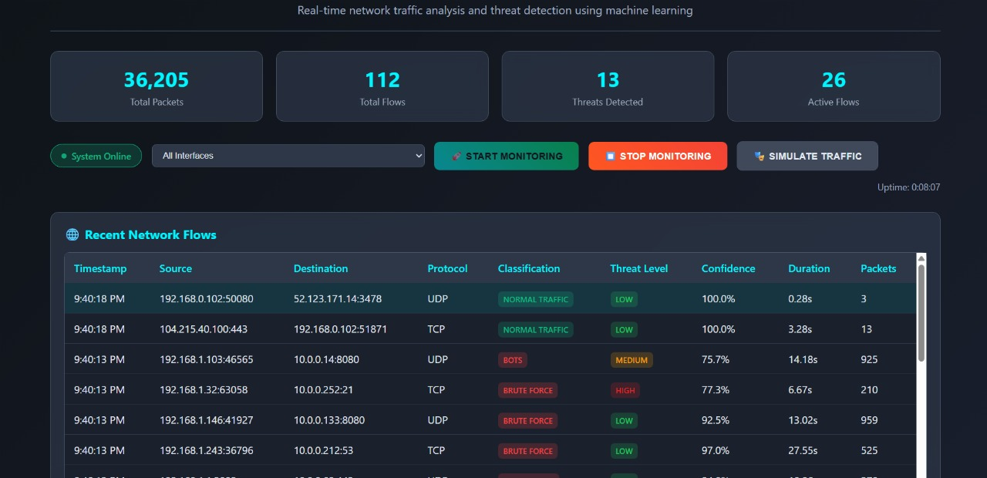

Slide 11
AI/ML for Networking
Deliverables
Trained Random Forest model (model_rf.pkl)
Real-time packet classification system (Python scripts)
Web-based dashboard for visualization and alerts
Documentation and test reports
Processed dataset for training and evaluation
Dept of Computer Science & Engineering

Slide 12
Thank You
Dept of Computer Science & Engineering

